Slide 1
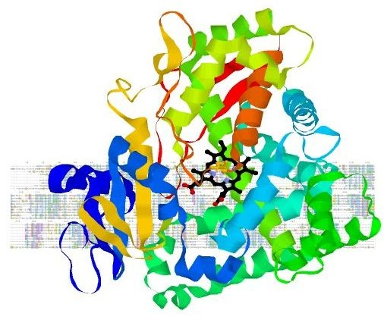
Introduction to Bioinformatic
Biotechnology Dept. Dr Arshad Hosseini
School of Allied Medical Sciences
Iran University of Medical Sciences
Introduction to Bioinformatic Workshop

Slide 2
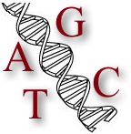
What is bioinformatics?
Bioinformatics: word was coined in 1978
Bio-: life
Informatics: information systems & computer science
Analysis of molecular biology data using techniques from information systems
computer science
artificial intelligence
statistics
mathematics
~computational biology
Molecular biology data?
DNA, RNA, genes, proteins…

Slide 3
Important sub-disciplines within bioinformatics
Development of new algorithms and statistics with which to assess relationships among members of large data sets
Analysis and interpretation of various types of data including nucleotide and amino acid sequences, protein domains, and protein structures
Development and implementation of tools that enable efficient access and management of different types of information” (NCBI)“
All biological computing are not bioinformatics, e.g. mathematical modelling is not bioinformatics, even when connected with biology-related problems

Slide 4
Bioinformatics
Artificial
Intelligence
Computational
Theory
Bio inspired
Computing
Data
Structure
Bioinformatics
Optimization
Computer
Network
Internet
Graphic
Computing
Parallel
Computing
Software
Engineering
Image
Processing
Database

Slide 5
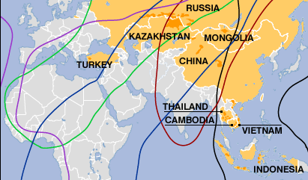
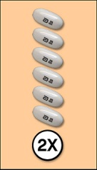
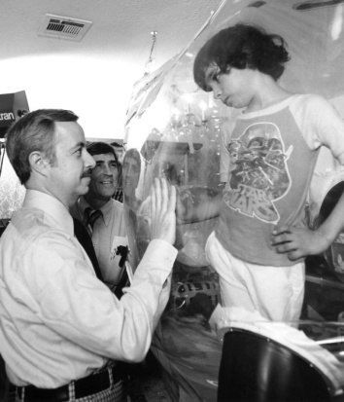

Aim of bioinformatics
“To improve the quality of life” by understanding how it works
Health
Disease prevention:
Detect people at risk
Change of lifestyle, diet…
e.g. risk of cardiovascular diseases – exercise…
Study virus evolution
e.g. bird flu virus
Treatment:
Quantitative evaluation of disease spread
Rational drug design
e.g. first efficient drug against HIV (Norvir 1996)
Gene therapy
e.g. “bubble” kids with no immune system
Animal model
e.g. zebra fish is the new mouse

Slide 6

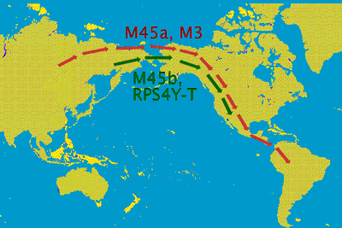
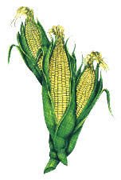
Other applications
Forensic (DNA fingerprints)
Criminal suspects (UK: database of 3M people)
Paternity tests
Identification of victims (Titanic, earthquakes…)
Prevent illegal trade (drugs, ivory…)
Paleoanthropology & archaeology
Human evolution
e.g. where is the first American from?
Food industry
GMOs (Genetically Modified Organisms)
Famine buster or Frankenfood?

Slide 7
Big Goal
Discovery of new biological insights
Create a global perspective of living system
Formulate unifying principles in biology
From ‘unknown’ to ‘known’
Fast , efficient way to extract information

Slide 8
Bioinformatics vs Computational Biology
Almost interchangeable
Computational biology may be broader
Computational biology is an interdisciplinary field that applies the techniques of computer science, applied mathematics and statistics to address biological problems
Includes bioinformatics

Slide 9
Impacts of Bioinformatics
On biological sciences (and medical sciences)
Large scale experimental techniques
Information growth
On computational sciences
Biological has become a large source for new algorithmic and statistical problems!

Slide 10
Related Fields
Proteomics/genomics (metagenomics)/ comparative genomics/structural genomics
Chemical informatics
Health informatics/Biomedical informatics
Complex systems
Systems biology
Biophysics
Mathematical biology
tackles biological problems using methods that need not be numerical and need not be implemented in software or hardware

Slide 11
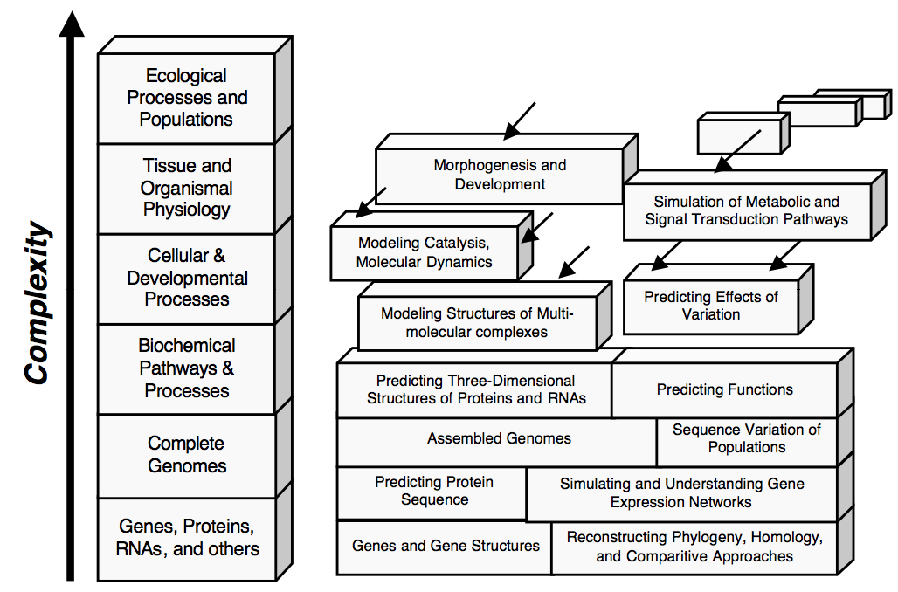
Bioinformatics Problems/Applications

Slide 12
Bioinformatics Flow Chart (0)
1a. Sequencing
1b. Analysis of nucleic acid seq.
6. Gene & Protein expression data
2. Analysis of protein seq.
7. Drug screening
3. Molecular structure prediction
Ab initio drug design OR
Drug compound screening in
database of molecules
4. molecular interaction
8. Genetic variability
5. Metabolic and regulatory networks

Slide 13
Bioinformatics Flow Chart (1)
1a. Sequencing
Base calling
Physical mapping
Fragment assembly
1b. Analysis of nucleic acid seq.
-gene finding
Multiple seq alignment
→ evolutionary tree
Stretch of DNA coding for protein;
Analysis of noncoding region of genome
2. Analysis of protein seq.
Sequence relationship
3. Molecular structure prediction
3D modeling;
DNA, RNA, protein, lipid/carbohydrate
Protein-protein interaction
Protein-ligand interaction
4. molecular interaction
5. Metabolic and regulatory networks
Notes:
This is more of a drug discovery perspective
Gene discovery require annotating genes
Many of the concepts here will be discussed through this course.

Slide 14
Bioinformatics Flow Chart (2)
6. Gene & Protein expression data
EST
DNA chip/microarray
7. Drug screening
Lead compound binds tightly to binding site of target protein
Lead optimization – lead compound modified to be nontoxic,
few side effects, target deliverable
Ab initio drug design OR
Drug compound screening in
database of molecules
Drug molecules designed to be complementary to binding
Sites with physiochemical and steric restrictions.
8. Genetic variability
Now investigated at the genome scale
SNP, SAGE

Slide 15
Why is Bioinformatics Important?
Applications areas include
Medicine
Pharmaceutical drug design
Toxicology
Molecular evolution
Biosensors
Biomaterials
Biological computing models
DNA computing

Slide 16
Why is bioinformatics hot?
Supply/demand: few people adequately trained in both biology and computer science
Genome sequencing, microarrays, etc lead to large amounts of data to be analyzed
Leads to important discoveries
Saves time and money

Slide 17


