Slide 1
روش تحقیق مقدماتی
پاییز 97
لیلا قالیچی
اپیدمیولوژیست

Slide 2
انواع کلی مطالعه
توصیفی
تحلیلی

Slide 3
اهداف مطالعه
تعیین وضعیت توزیع صفات کمی و کیفی در جوامع در زمان مشخص
تعیین روابط بین صفات و نوع این روابط

Slide 4
مطالعات توصیفی
کمی (تمرکز بر زمان و مکان و شخص)

Slide 5
انواع مطالعات تحلیلی
مشاهده ای
مداخله ای

Slide 6
Cohort
Case-Control
Ecologic
Analytical
‍Cross-Sectional
Case Series
Case Report
Descriptive
Observational

Slide 7
Case Reports and Case Series
Describe the occurrence of new disease entities.
Describe the outcome of patients with specific diseases.
Allows for the description of outcomes associated with rare diseases.
Formulate hypotheses

Slide 8
Limitations of Case Report & Case Series
Impossible to determine disease frequency.
Cannot establish causality between exposures or risk factors and disease or outcome.

Slide 9
Cross-sectional studies

Slide 10
Cross Sectional Studies
Disease Status
Yes
No
Total
Exposure
Status
Yes
a
b
a +b
No
c
d
c +d
a +c
b +d
N

Slide 11
Cross-sectional studies
Cross-Sectional Studies measure existing disease and current exposure levels.
They provide some indication of the relationship between the disease and exposure or non-exposure
Mostly prevalence studies/surveys

Slide 12
Cross Sectional Studies
(Advantages)
Good design for hypothesis generation
Can estimate exposure proportions in the population
Can study multiple exposures or multiple outcomes
Relatively easy, quick and inexpensive
Best suited to study permanent factors (breed, sex, blood-type)
Often good first step for new study issue

Slide 13
Cross Sectional Studies
(Disadvantages)
Impractical for rare diseases
Problems with temporal sequence of data
Not a useful type of study for establishing causal relationships
Confounding is difficult to control
hard to decide when disease was actually acquired
miss diseases still in latent period
recall of previous exposure may be faulty

Slide 14
Case-control studies

Slide 15
Exposure
Outcome

Slide 16
Case-Control
Unexposed
Exposed
Control
Unexposed
Exposed
Case
Study Population

Slide 17
Case-Control stydies
Disease Status
Yes
No
Total
Exposure
Status
Yes
a
b
a +b
No
c
d
c +d
n1
a +c
b +d
N
n2

Slide 18
Steps
Hypothesis definition
Selection of cases and controls
Exposure measurement
Analysis & interpretation

Slide 19
Special features of case control study
Studying diseases with long latency
Efficient in time and cost
Suitable for rare diseases
Wide range of potential exposure

Slide 20
Cohort studies

Slide 21
Exposure
Outcome

Slide 22
Cohort studies
Disease Status
Yes
No
Total
Exposure
Status
Yes
a
b
n1
a +b
No
c
d
c +d
n2
a +c
b +d
N

Slide 23
Cohort
-Disease
Disease +
Unexposed
-Disease
Disease +
Exposed
Study Population
(Non-diseased)

Slide 24
Steps
Hypothesis definition
Selection of exposed and unexposed
Follow-up and outcome measurement
Analysis & interpretation

Slide 25
Selection of the Exposed Population
Sample of the general population:
Geographically area, special age groups, birth cohorts
A group that is easy to identify:
Nurses health study
Special population (often occupational epidemiology):
Rare and special exposure

Slide 26
Cohort
Present Time
Exposure
Outcome
Exposure
Outcome
Exposure
Outcome

Slide 27
Comparing cohort and case control
 | Case control | cohort
Study group | Diseased/ healthy | Exposed/ unexposed
temporality | Hard to establish | Easy to establish
multiple | exposures | outcomes
time | short | Long
cost | inexpensive | Expensive
Best when | D rare E frequent | E rare D frequent
Problems | Control selection Exposure information | Unexposed selection change over time

Slide 28
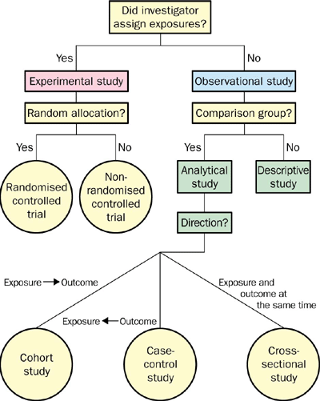

Slide 29

The Hierarchy of Evidence
Systematic reviews & meta-analyses
Randomised controlled trials
Cohort studies
Case-control studies
Cross sectional surveys
Case reports
Expert opinion
Anecdotal

Slide 30
Any questions?
Email: ghalichi.l@iums.ac.ir

