Slide 1
مروری بر
برنامه کاهش آسیب در ایران
دکتر علیرضا نوروزی
روانپزشک، سرپرست اداره پیشگیری و درمان اعتیاد
دکتر سیدابراهیم قدوسی
کارشناس ارشد پیشگیری و درمان اعتیاد

Slide 2
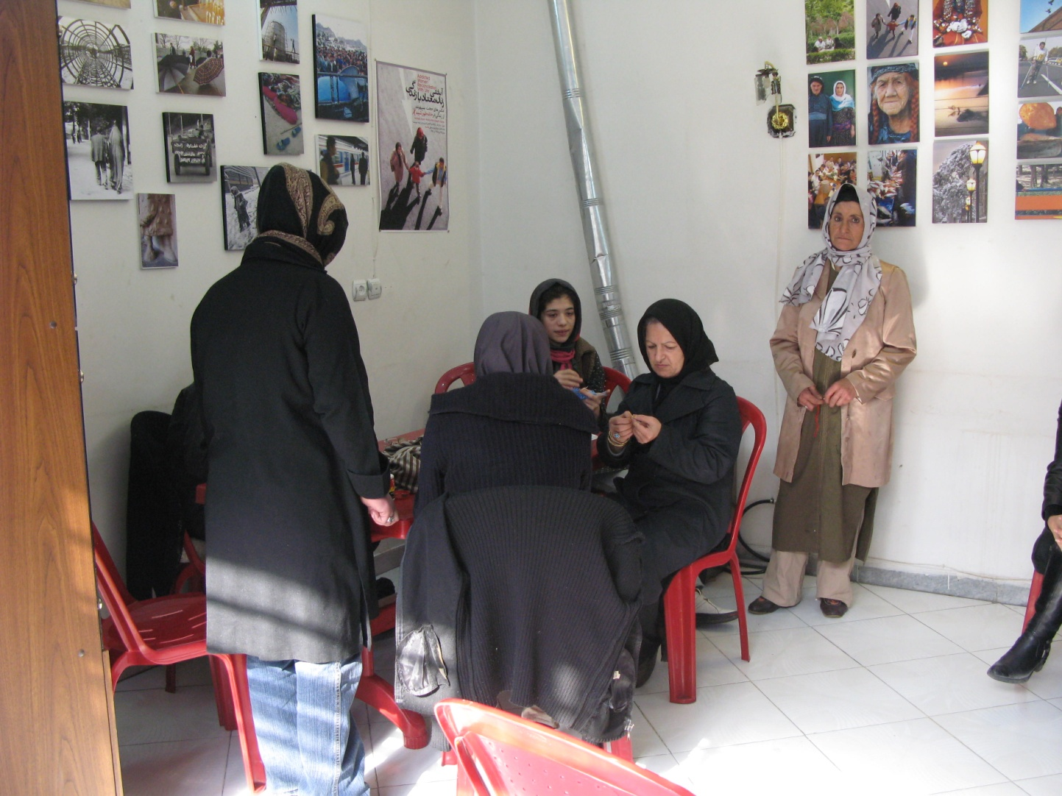

Slide 3
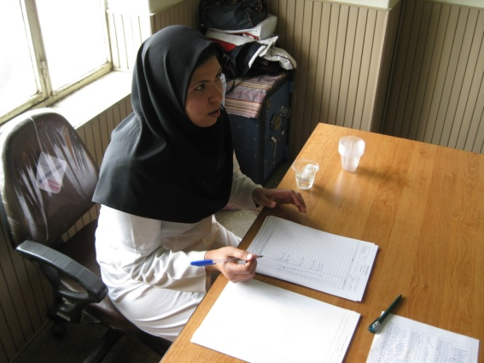
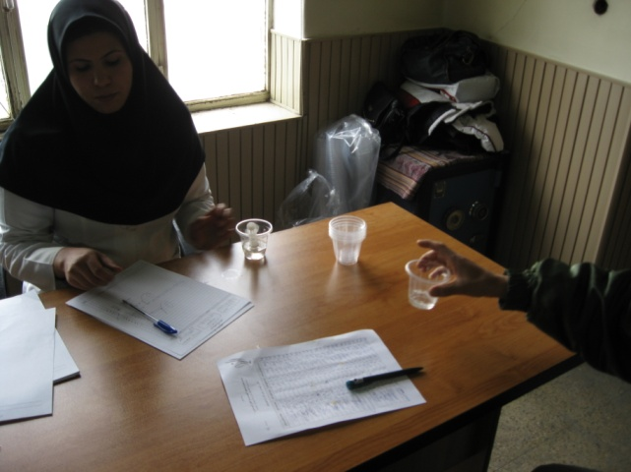
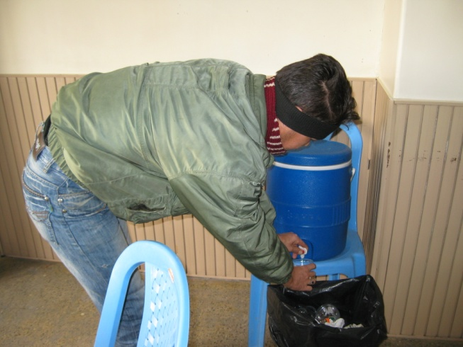

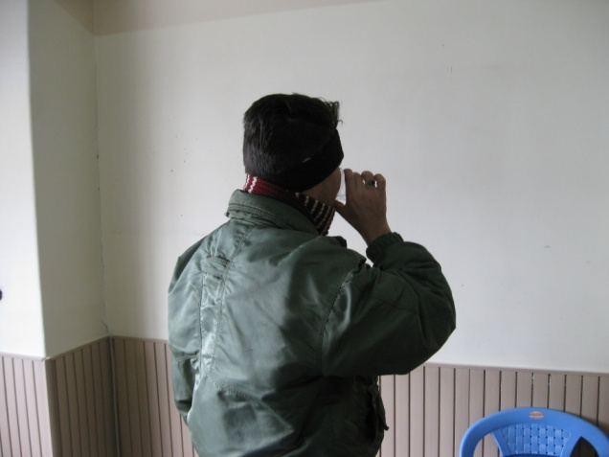

Slide 4
اختصاصات مرکز گذری
فضای فیزیکی مراکز گذری
جانمایی مراکز گذری
خدمات مرکز گذری
  تعویض سرنگ و سرسوزن
  تحویل کاندوم
  خدمات سیاری
  مشاوره مختصر
  سرپناه روزانه
  تغذیه مختصر
  استحمام
  تحویل مختصر البسه
  متادون آستانه پایین
  ارجاع بیماران برای ادامه درمان نگهدارنده با متادون
  ارجاع برای VCT به مراکز مشاوره بیماریهای رفتاری

Slide 5
Scope of The Problem
It is estimated that there are 15.9 million (11.0 to 21.2 million) people who inject drugs (PWIDs) worldwide and 3 million (18.9%) of them live with HIV.
The prevalence of hepatitis C and hepatitis B among injecting drug users are 46.7 and 14.6 percent respectively.
With the exception of sub-Saharan Africa, injecting drug use accounted for approximately one third of all new HIV infections reported globally in 2010 (UNAIDS, 2011).

Slide 6
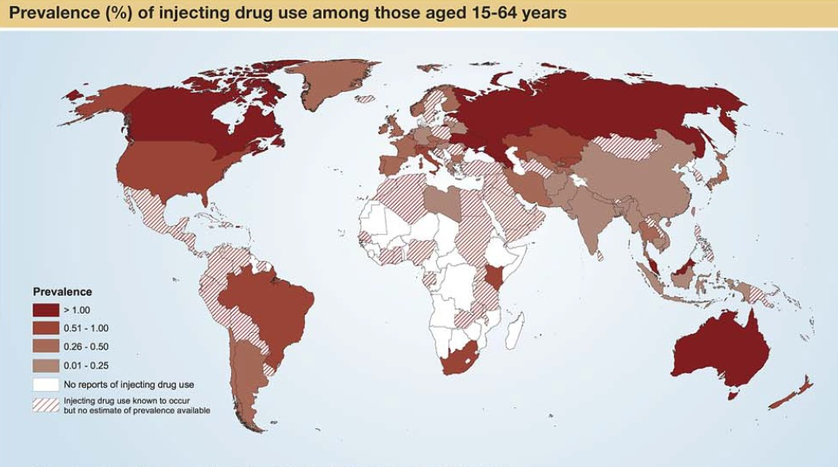
UNODC 2009

Slide 7
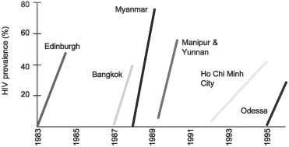
HIV infection can rapidly turn into an epidemic among injection drug users especially in areas where extensive prevention activities are not delivered (De Jarlais and Friedman, 1991).
Lowndes 2003

Slide 8
The “Rapid Situational Analysis of Drug Abuse in Iran” (2007) revealed that:
%18.1 of 1.2 million drug users reported injection as their main route of administration
26.1% had a lifetime history of IV drug use
22% had a last year history of injecting drug use and
6.7% reported using needle, syringe or paraphernalia previously used by other drug users

Slide 9
Introduction
In the first round of bio-behavioural surveillance survey in 2007, prevalence of HIV infection amongst IDUs recruited from 10 urban areas averaged 15.3%.
In Iran the HIV surveillance system in 2010 showed the main rout of HIV transmission in 67% of identified cases was IV drug use.
In the field of HCV studies, the prevalence of HCV infection in IDUs has been reported from 11.2 up to 89.5%.

Slide 10
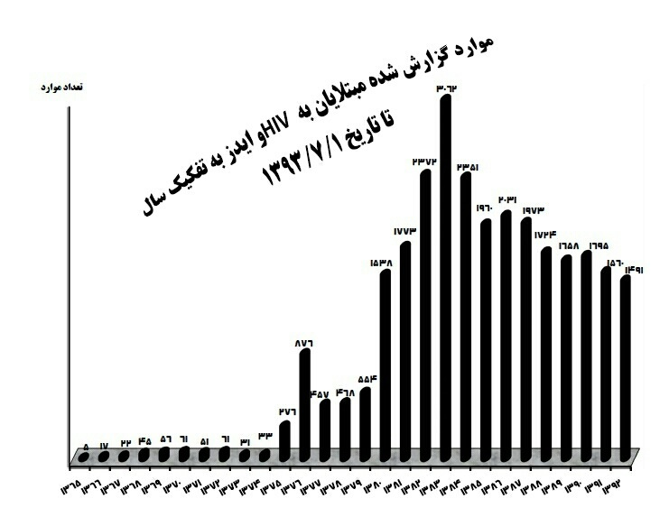

Slide 11
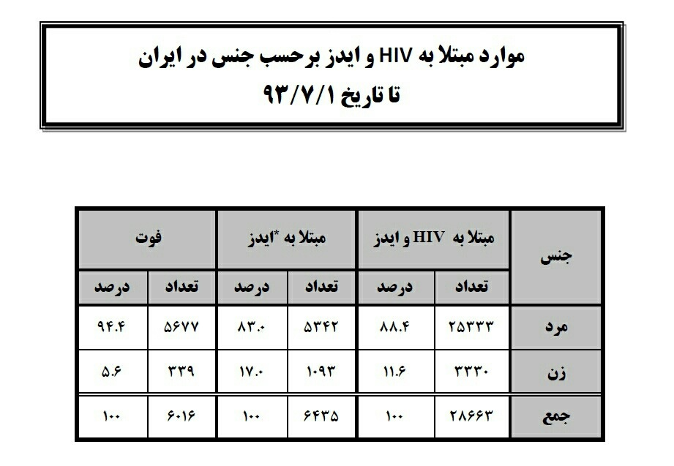

Slide 12
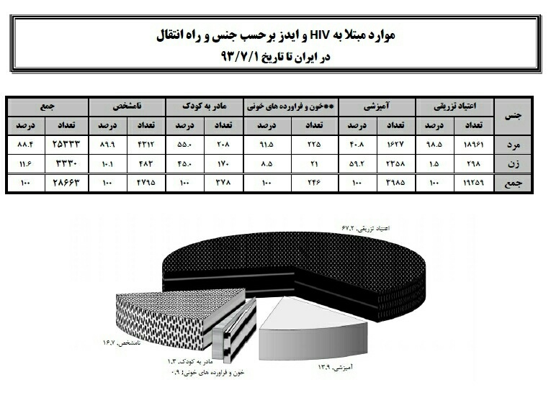

Slide 13
Needle Syringe, Programs (NSPs)
Needle and syringe programmes (NSP) are a critical component of harm reduction interventions to reduce transmission of BBVs among IDUs.
NSPs usually consist of fixed-site specialist services, although alternative access is offered through, for example, pharmacies, vending machines and outreach.
In Iran, primary NSPs are mainly delivered as part of a package of services through Drop 0n Center and outreach teams.

Slide 14
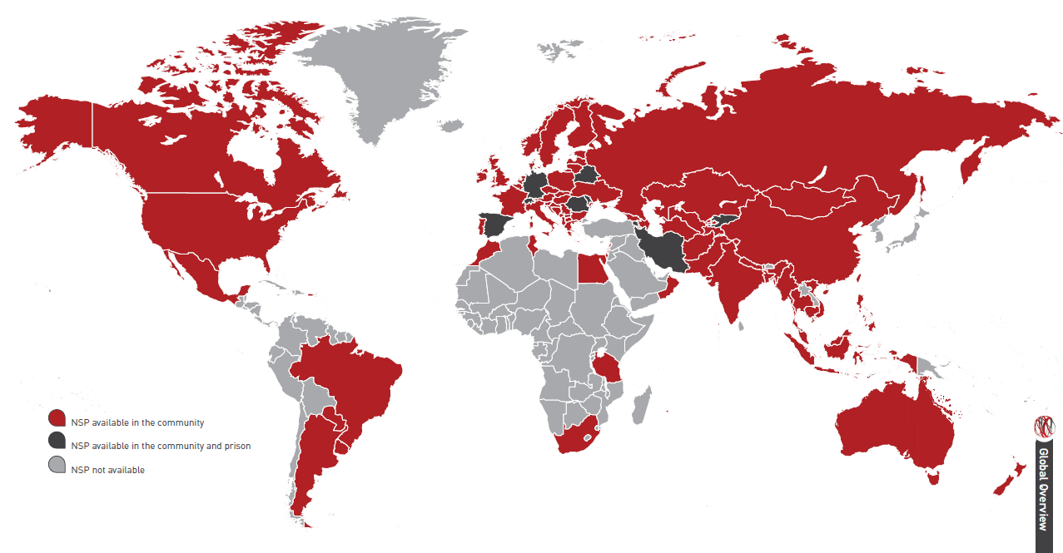

Slide 15
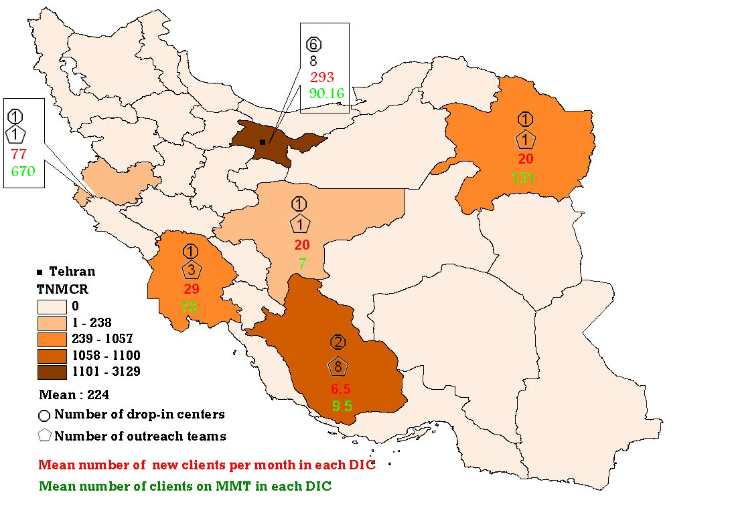
Needle, Syringes Programs in 1384 (2005)
DIC: 8
Outreach Teams: 14
Mean No. of New Client per Month in Each DIC: 152.5
Mean Number of Clients on MMT in Each DIC: 888.5

Slide 16
NSP Program 1386 (2007)
Number of DICs

Slide 17
Proportion of DIC per 100,000 Population

Slide 18
Proportion of No. of Clients to Population

Slide 19
Proportion of Female to Male Clients

Slide 20
Average No. of Clients for Each DIC

Slide 21
No. of MMT@DIC Clients

Slide 22
No. of Identifies HBV+ Clients

Slide 23
No. of Identified HCV+ Clients

Slide 24
No. of Identifies HIV+ Clients

Slide 25
No. of Distributed Syringes

Slide 26
Average No. of Distributed Syringes per Client

Slide 27
No. of Distributed Condoms

Slide 28
Proportion of Referral to Behavioral Counseling Centers

Slide 29
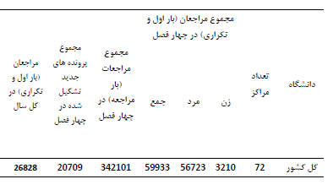
DIC & Outreach Services 1387

Slide 30
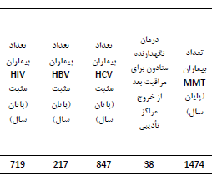

Slide 31
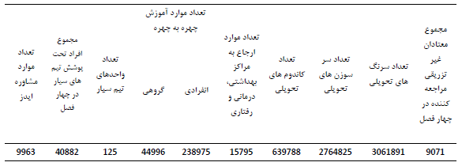
114 syringes distributed per client per year

Slide 32
Number of Syringes distributed per person who injects drugs per year by Needle and Syringe Programmes, 2011
Over a one-year period ending in September 2011, 6,022,834 free needles and syringes have been distributed.
Between 26 to 35 needle and syringe per IDU per year were distributed.

Slide 33
People who inject drugs: Safe injecting practices Definition of indicator, 2011
1463 out of 1595 (91.7%) of study population used sterile injecting equipment the last time they injected.
The figure was 91.9% (1439 out of 1566) in male IDUs, 82.8% (24 out of 29) in female IDUs and 91.1% (173 out of 190) in those IDUs under 25 years old.

Slide 34
Percentage of people who inject drugs reporting the use of a condom the last time they had sexual intercourse
15.1% (240 out of 1595) used condom in their last intercourse with their wife,
16.2% (258 out of 1595) used condom in their last intercourse with their non-paid sexual partner,
15.3% (244 out of 1595) used condom in their last intercourse with their paid partner.

Slide 35
HIV prevalence in people who inject drugs
13.6% of IDUs (338 out of 2479) was HIV positive.
The prevalence of HIV among male IDUs were 13.8% (332 out of 2417), 9.7 %( 6 out of 62) in female IDUs and 6.6% for those less than 25 years old.

Slide 36
ممنون از توجه شما

